Slide 1
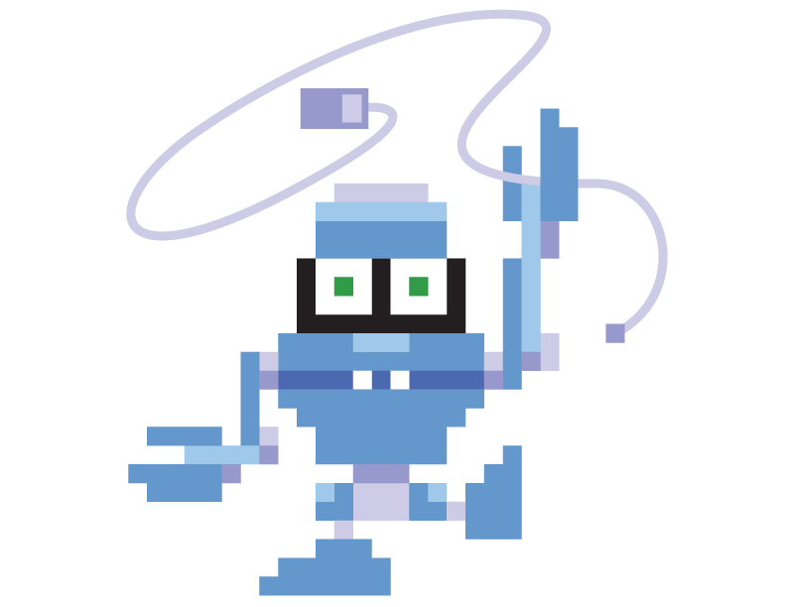
ByteFest 2015 Spring
Open Coding Session

Slide 2
What is ByteFest
ByteFest is a 2 part high school programming competition
You compete on a team of 2-4 students against teams from other schools
Part 1 (optional), this week-long open coding session and team presentation on Saturday.
Part 2, Saturday’s in person contest where you solve problems in a timed setting.
Winners get prizes, everyone gets entered into a random drawing for other prizes

Slide 3
There’s a GitHub Repository
It has what you’ll want to know…
github.com/ByteFest/
Seriously, it has:
The problems
The rubric
Presentation advice
This presentation

Slide 4
Rules
You’re welcome to use any reference material you can find on the internet for this week long problem.
You’re encouraged to work with your team, but should not be working with other teams or getting help from teachers, coaches, or parents.
Solve the problem in either Java, C++, or Python

Slide 5
What to do this week
Check out ByteFest on Github
Check out PC^2
Solve the two problems (as a team)
Prepare a team presentation for Saturday on your solution to the trading post problem

Slide 6
How to Submit Your Solutions
PC^2 is a program we use to evaluate your code.
When you think you have a working piece of code, go to: bytefest.pnnl.gov
And submit your code.
There’s a troubleshooting guide on the github repo if you have problems

Slide 7
What not to worry about
Solving the week long problem fast (We want to see a good solution, not a quick messy one)
Not being able to solve the week long problem or the problems on Saturday (we give partial credit)
Submitting a solution multiple times
Bringing computers or software on Saturday – we’ll have everything you’ll need

Slide 8
Where to Be on Saturday
You need to be at Tri-tech Skills Center at or before 9:00 am. Presentations begin at 9:00 am.
We will be done at 1:00 pm
You should bring a lunch
You should bring your teammates (make sure they don’t sleep in)
Be ready for some fun!

